Slide 1

Amazon Musical Instrument Data
What is most popular?
Patrick Aslakson
IST 652 - Final Project Presentation

Slide 2
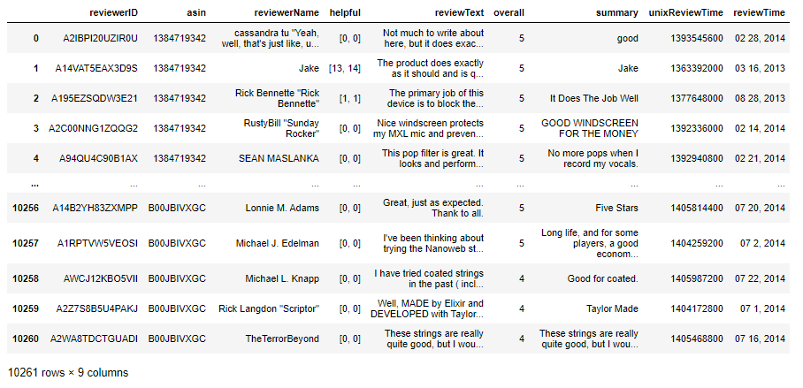
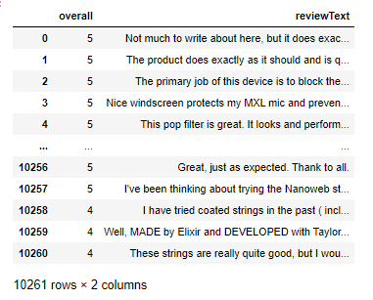
Data
Raw Data:
https://www.kaggle.com/eswarchandt/amazon-music-reviews
Back up Data Source:
http://jmcauley.ucsd.edu/data/amazon/
Pay for Info Sites:
https://www.musictrades.com/census.html
https://www.statista.com/outlook/19020000/109/musical-instruments/united-states

Slide 3
Question to answer from the Data
What are the sales of highly reviewed and regarded guitar brands like Gibson on Amazon?

Slide 4
Program Description
Data sourced from Amazon - JSON data file
Pandas dataframe
Sentiment analysis
Tokenization
Parsing

Slide 5
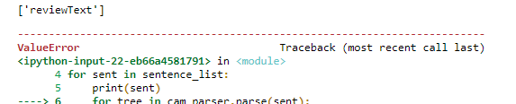
Output & Conclusions
Output:
Sentiment - reviewText
compound: 0.0, neg: 0.0, neu: 1.0, pos: 0.0
Conclusions:
While Amazon is the shopping place of a lot of Americans, the 2013 – 2014 data for musical instruments from Amazon does not shed much light on people’s preferences for guitars in the online marketplace especially for specific information for Gibson Guitars. My overall topic of interest is probably too specific for this one dataset. I would need to look into the individual guitar makers sales data to better determine some of the answer my question of what has caused the downturn in sales for Gibson causing their 2018 bankruptcy.

Slide 6
Improvements
Better focused data / Manufacturer data
Pay Data

Slide 7
Questions about the Presentation

